Slide 1
Home Repairs
29 Reported speech modals, orders and requests

Slide 2
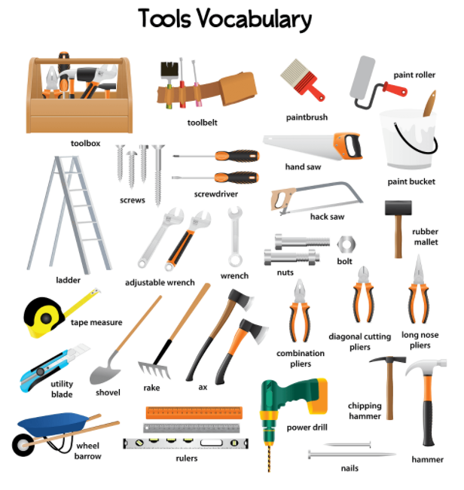
Home repairs
Do you repair things at home?
What tools do you know how to use?
Is hiring a professional expensive?

Slide 3
Reported speech, modals
Modal changes
Can | Could
Will | Would
Must | Had to
Have to | Had to
In Reported Speech, certain modals change.
“Can I help you?”
He asked if he could help me.
“You must be home by 10:30.”
She said (that) I had to be home by 10:30.
Could, would, should, and might don’t change.
“They should lend him the money.”
She said that they should lend him the money.

Slide 4
Report these sentences
“I can’t use the electric screwdriver,” the boy complained.
“We can lend you some money,” they told us.
“I must repair this chair,” the man said.
“We have to make ends meet,” she explained.
“Paul could give you a steady job,” she told me.
“My parents would lend you a hammer,” the boy said to her.
“These tools might come in handy,” the man told us
“I have to use a hammer to nail the picture,” he explained.
“You can have a small tool box for emergencies,” a manual mentioned.
“Construction workers will come at 9 am,” the contractor told me.
Notes:
The boy complained that he couldn’t use the electric screwdriver
They said that they could lend us some money
The man said that he had to repair that chair.
She explained that they had to make ends meet
She told me that Paul could give me a steady job.
The boy said to her that his parents would lend her a hammer.
The man told us that those tools might come in handy.
He explained that he had to use a hammer to nail the picture.
A manual mentioned that you could have a small tool box for emergencies.
The contractor told me that construction workers would come at 9am.

Slide 5
Reporting a Command or a Request
When we report a command or a request:
we drop the quotation marks and the comma after the reporting verb.
we always start with a reporting verb, such as: ask, tell, order, command, instruct, warn, beg.
we add a noun or pronoun + to + base form of the verb when the command is positive.
we add not to + base form of the verb when the command is negative.
we drop the word please.
The thief said, “Give me the money!”
The thief ordered the bank teller to give him the money.
She said, “Please don’t smoke in the office.”
She told him not to smoke in the office.

Slide 6

Report these commands
“Don’t bring me the electric screwdriver!” Tom told Harry
“Please help me get out of debt,” he begged us.
“Stay here until the fire drill is over,” the teacher ordered the children.
Grant asked Joe, “Lend me your hammer, please.”
“Repair this table and these chairs,” the boss ordered his workers.
“Please give me back my tools,” Penny asked us.
“Help me pay back the loan, please,” he asked his parents
The inspector told them, “use a helmet in the construction site!”
“Wear gloves when you paint,” the clerk suggested.
“Use the tape measure; don’t make a rough guess,” the instructions said.
Notes:
Tom told Harry not to bring him the electric screwdriver.
He begged us to help him get out of debt.
The teacher ordered the children to stay there until the fire drill was over.
Grant asked Joe to lend him his hammer.
The boss ordered his workers to repair that table and those chairs.
Penny asked us to give her back her tools.
He asked his parents to help him pay back the loan.
The inspector told them to use a helmet in the construction site.
The clerk suggested to wear gloves when we paint.
The instructions said to use the tape measure, not to make a rough guess.

Slide 7
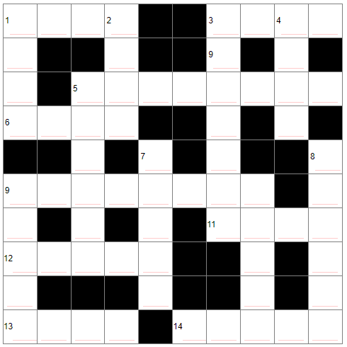
Crossword puzzle: Home
Across
1. Most people sleep in them..
3. When it is _________, turn on the light.
5. Close them at night, so that people can't see into your house from outside.
6. It is produced by a fire or by a radiator.
9. Piece of furniture, often in the kitchen, in which one keeps food, plates
11. Comfortable seat for two or three.
12. The very top level of a house.
13. This keeps a house dry when it rains
14. Small tables at which people work
Down
1. Lie in it to get clean.
2. You can see through windows even if they are _________.
3. Things in which people usually keep clothes, knives and forks, and other small items.
4. When visitors arrive, they may ______ the doorbell.
5. Soft covering on the floor.
7. Shelter often outside the front door of a house
8. Go up them if you want to reach the upper floor of a house .
9. Something on which you sit.
10. Go through them, to enter rooms.
Notes:
Across
1. Most people sleep in them. BEDS
3. When it is _________, turn on the light. DARK
5. Close them at night, so that people can't see into your house from outside. CURTAINS
6. It is produced by a fire or by a radiator. HEAT
9. Piece of furniture, often in the kitchen, in which one keeps food, plates CUPBOARD
11. Comfortable seat for two or three. SOFA
12. The very top level of a house. ATTIC
13. This keeps a house dry when it rains. ROOF
14. Small tables at which people work. DESKS
Down
1. Lie in it to get clean. BATH
2. You can see through windows even if they are _________. SHUT
3. Things in which people usually keep clothes, knives and forks, and other small items. DRAWERS
4. When visitors arrive, they may ______ the doorbell. RING
5. Soft covering on the floor. CARPET
7. Shelter often outside the front door of a house. PORCH
8. Go up them if you want to reach the upper floor of a house. STAIRS
9. Something on which you sit. CHAIR
10. Go through them, to enter rooms. DOORS

